Slide 1
zekeLabs
Cassandra - Architecture & Internals
Learning made Simpler ! www.zekeLabs.com

Slide 2
Architecture in brief
Inter-node communication
Data distribution & replication
Partitionars
Storage Engine
How Cassandra reads & writes data
Agenda

Slide 3
Write Operation
Node is the place where data is stored. It is the basic component of Cassandra.
A collection of nodes are called data center. Many nodes are categorized as a data center.
The cluster is the collection of many data centers.
Every write operation is written to Commit Log. Commit log is used for crash recovery.
After data written in Commit log, data is written in Mem-table. Data is written in Mem-table temporarily.
When Mem-table reaches a certain threshold, data is flushed to an SSTable disk file.

Slide 4
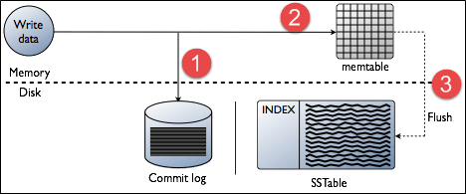
Write in Cassandra

Slide 5
Read in Cassandra
Check the memtable
Check row cache, if enabled
Checks Bloom filter
Checks partition key cache, if enabled
Goes directly to the compression offset map if a partition key is found in the partition key cache, or checks the partition summary if not
If the partition summary is checked, then the partition index is accessed
Locates the data on disk using the compression offset map
Fetches the data from the SSTable on disk

Slide 7
Gossip - Internode communication
A peer-to-peer communication protocol to discover and share location and state information about the other nodes in a Cassandra cluster.
Gossip information is also persisted locally by each node to use immediately when a node restarts.

Slide 8
Data distribution using Partitioner
A partitioner determines which node will receive the first replica of a piece of data, and how to distribute other replicas across other nodes in the cluster.
Each row of data is uniquely identified by a primary key, which may be the same as its partition key, but which may also include other clustering columns.
A partitioner is a hash function that derives a token from the primary key of a row. The partitioner uses the token value to determine which nodes in the cluster receive the replicas of that row.

Slide 9
Replication Factor & Strategy
How many replica ?
And, where does the replica exist

Slide 10
Thank You !!!

Slide 11
THANK YOU
Let us know how can we help your organization to Upskill the employees to stay updated in the ever-evolving IT Industry.
Get in touch:
www.zekeLabs.com | +91-8095465880 | info@zekeLabs.com
Visit : www.zekeLabs.com for more details

